Slide 2
WHAT IS
TRUTH?

Slide 6
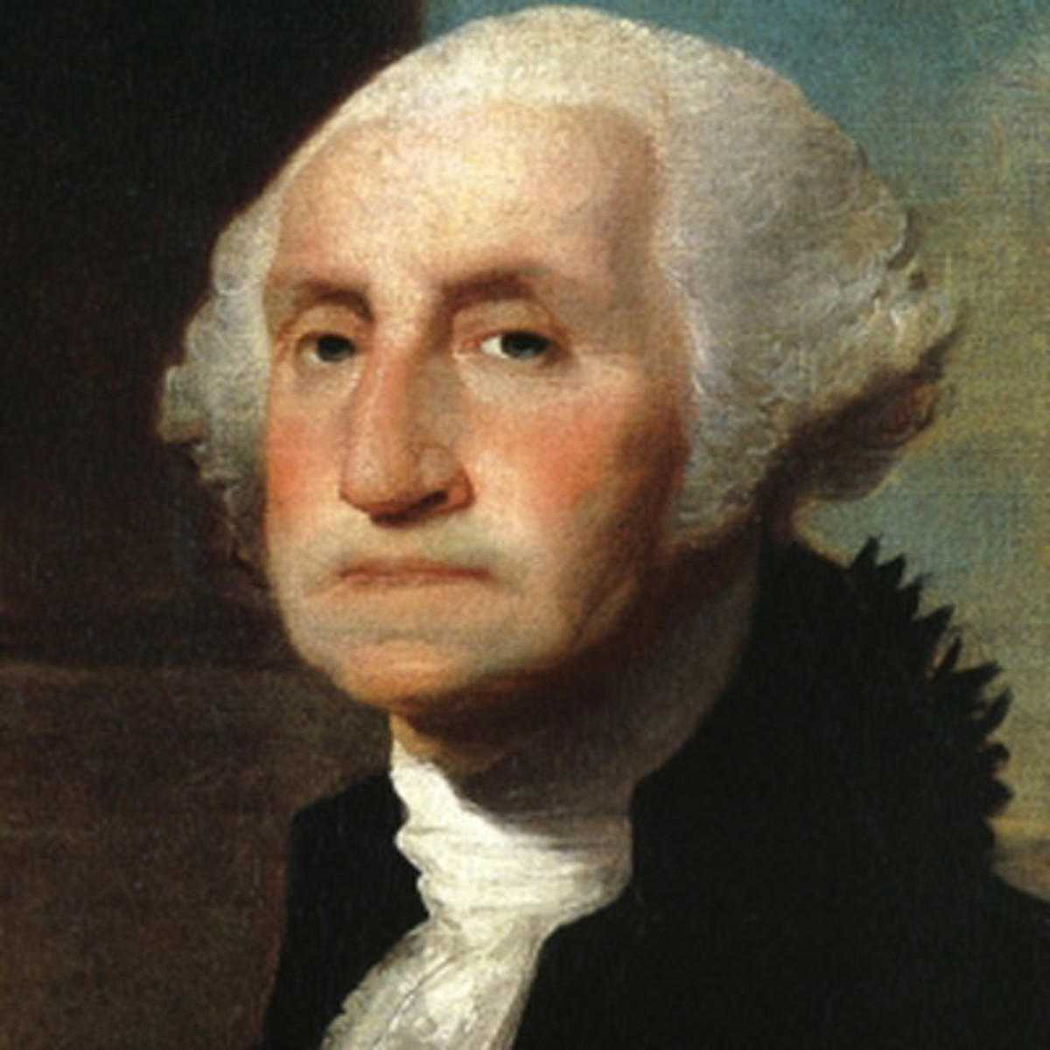

Slide 7
WITNESSES TO THE TRUTH

Slide 8
THE BIBLE
ITSELF

Slide 9
2000 YEARS
40 AUTHORS
ONE MESSAGE

Slide 10
GENESIS 1:1
JOHN 1:3
MARK 10:6

Slide 11
GENESIS 7:7
2 PETER 3:6
MATT 24:38

Slide 12
PSALM 16:10
1 COR 15:4
JOHN 2:19

Slide 13
For no prophecy was ever produced by the will of man, but men spoke from God as they were carried along by the Holy Spirit. - 2 Peter 1:20-21

Slide 14
But as for you, continue in what you have learned and have firmly believed, knowing from whom you learned it and how from childhood you have been acquainted with the sacred writings, which are able to make you wise for salvation through faith in Christ Jesus.

Slide 15
All Scripture is breathed out by God and profitable for teaching, for reproof, for correction, and for training in righteousness, that the man of God may be complete, equipped for every good work.
(2 Timothy 3:16-17)

Slide 16
And we also thank God continually because, when you received the word of God, which you heard from us, you accepted it not as a human word, but as it actually is, the word of God, which is indeed at work in you who believe.
1 Thessalonians 2:13

Slide 17
In 1 Timothy 5:18, Paul quoted the Gospel of Luke as “Scripture,” on par with the inspired writings of Moses, citing both Deuteronomy 25:4 and Luke 10:7.

Slide 18
ISTORY
AND
ARCHAEOLOGY

Slide 19
In archaeology, the absence of evidence is not evidence of absence.

Slide 20
THREE
EXAMPLES

Slide 21
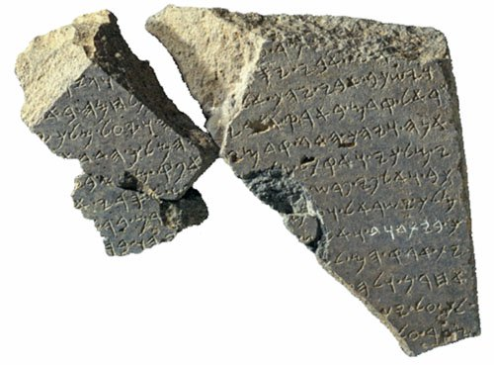
KING
DAVID

Slide 22
1993 discovery of ancient inscription dated from 9th century BC that talks about the “House of David” --‘proving’ that he was more than a legend.

Slide 23
OLD TESTAMENT
AS SCRIPTURE

Slide 24
Two scrolls found in Jerusalem from around 600BC that include parts of the book of Numbers—showing that parts of the OT was considered sacred text before many even thought it existed.

Slide 25
NATION
OF ISRAEL

Slide 26
Inscription around 1200 BC from Egypt that refers to Israelites as a distinct nation.

Slide 27
SCIENCE

Slide 28
ISAIAH 40:22
(700 BC)

Slide 29
PYTHAGORAS
(200 YEARS LATER)

Slide 30
JOB 26:7
(700 BC)

Slide 31
NEWTON
1600s-1700s

Slide 32
ECC. 1:6
(300 BC)

Slide 33
GEORGE
HADLEY
(1700s)

Slide 34
PSALM 8:8 (1200 BC)

Slide 35
WILLIAM
FONTAINE
MAURY
(1847)

Slide 36
JESUS AND THE
RESURRECTION

Slide 37
Ultimately, we believe the Bible because Jesus believed the Bible, and we believe Jesus because he rose from the dead.

Slide 38
We have far more sources for Jesus of Nazareth than we do for many historical figures in the first century. We have at least 18. Twelve of those are non-Christian sources.

Slide 39
MINIMAL FACTS
NEEDED:

Slide 40
Jesus died by crucifixion.

Slide 41
Jesus’ disciples believed that he rose and appeared to them.

Slide 42
The church persecutor Paul was suddenly changed.

Slide 43
The skeptic James, brother of Jesus, was suddenly changed.

Slide 44
The tomb was empty.

Slide 45
These facts are nearly universally accepted by all New Testament scholars.

Slide 46
If Jesus rose from the dead…
And Jesus believed the Bible was true…
…certainly we should believe it is…

Slide 47
WITNESSES
- THE BIBLE ITSELF
- HISTORY/ARCHAEOLOGY
- SCIENCE
- THE RESURRECTION

